Slide 1
MLflow: Managing the Machine Learning Lifecycle

Slide 2
What is MLflow?
Definition
MLflow is an open-source platform designed to manage the machine learning lifecycle.
It helps developers and data scientists track experiments, manage models, evaluate performance, and deploy models.
Key Features
Experiment Tracking – Record parameters, metrics, and results.
Model Management – Save and package trained ML models.
Model Registry – Manage different versions of models.
Model Evaluation – Evaluate and compare model performance.
Model Deployment – Deploy models for prediction.
Dataset Tracking – Track datasets used during experiments.
Simple Example
Instead of manually remembering:
"Which dataset, algorithm, and parameters produced this model?"
MLflow records this information automatically.

Slide 3
Why Use MLflow?
Common Problems in Machine Learning
Difficult to track multiple experiments.
Hard to reproduce previous results.
Different team members may use different environments.
Managing multiple model versions becomes complicated.
Moving a model from development to production can be difficult.

Slide 4
How MLflow Helps ?
Provides a centralized platform for ML lifecycle management.
Records experiment parameters and results.
Makes experiments reproducible.
Provides model version control.
Simplifies model deployment.
Improves collaboration between data scientists and ML engineers.
Key Idea
MLflow brings organization and traceability to the ML development process.

Slide 5
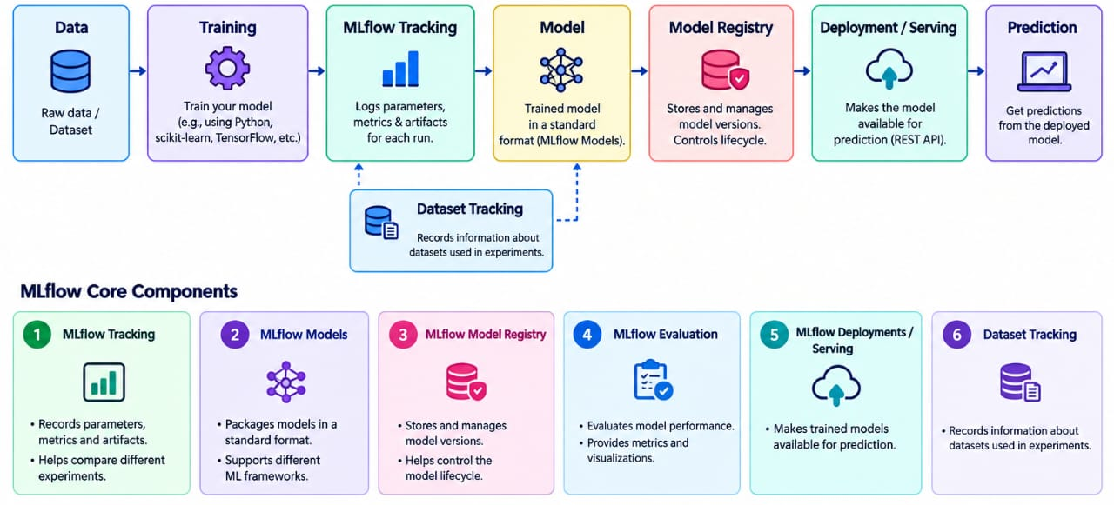
MLflow Architecture & Core Components

Slide 6
Experiment Tracking
What is Experiment Tracking?
Experiment tracking means recording the details and results of every ML experiment.
MLflow Tracking can record:
Parameters – Learning rate, number of trees, batch size, etc.
Metrics – Accuracy, precision, recall, F1-score, RMSE, etc.
Artifacts – Model files, graphs, datasets, logs, etc.
Source Code – Information about the code used.
Dataset Information – Details about training data.

Slide 7
EXAMPLE
RunAlgorithmAccuracy
Run 1 | Logistic Regression | 82%
Run 2 | Random Forest | 89%
Run 3 | SVM | 86%
Suppose we train three models:
MLflow allows us to track and compare these runs.

Slide 8
MLflow UI
The MLflow UI provides a visual interface to:
View experiments
Compare runs
Analyze metrics
View logged artifacts

Slide 9
MLflow Models & Flavors
An MLflow Model is a standard way of packaging a machine learning model so that it can be used across different environments.
Model Flavors
MLflow supports different ML libraries through model flavors.
Examples:
Scikit-learn
TensorFlow
PyTorch
XGBoost
Spark ML
Python Function (PyFunc)

Slide 10
MLflow Models & Flavors
Model Signature
A model signature describes:
Expected input format
Input data types
Output format
Output data types
Environment Capture
MLflow can record the dependencies required to run a model.
Benefit
The same trained model can be moved from development to another environment with fewer compatibility problems.

Slide 11
Model Registry
What is Model Registry?
MLflow Model Registry is a centralized system for managing and organizing machine learning models.
Main Functions
Store registered models.
Maintain different model versions.
Track model lineage.
Add descriptions and metadata.
Manage model lifecycle.
Support collaboration between teams.

Slide 12
Model Registry
Example
A model may have:
Customer Churn Model
Version 1 → Initial model
Version 2 → Improved accuracy
Version 3 → Final model
Each version can be tracked separately.
Model Lifecycle
Development → Testing → Production → Archived

Slide 13
Common Problems in Machine Learning
Difficult to track multiple experiments.
Hard to reproduce previous results.
Different team members may use different environments.
Managing multiple model versions becomes complicated.
Moving a model from development to production can be difficult.

Slide 14
Common Problems in Machine Learning
Difficult to track multiple experiments.
Hard to reproduce previous results.
Different team members may use different environments.
Managing multiple model versions becomes complicated.
Moving a model from development to production can be difficult.

Slide 15
Model Evaluation
Model evaluation determines whether a trained model performs well on the required task.
MLflow provides tools to:
Calculate evaluation metrics.
Compare model performance.
Analyze predictions.
Generate evaluation results.
Support custom evaluation methods.

Slide 16
Common Metrics
For classification:
Accuracy
Precision
Recall
F1-score
ROC-AUC
For regression:
MAE
MSE
RMSE
R² Score
Example
Two models are evaluated:
Model A
Accuracy = 85%
Model B
Accuracy = 91%

Slide 17
Model Deployment
What is Model Deployment?
Model deployment means making a trained ML model available so that it can receive new data and generate predictions.
MLflow can support model deployment through different environments.
Deployment Options
Local machine
REST API / Model Serving
Docker containers
Cloud platforms
Kubernetes-based environments
MLflow-compatible deployment targets

Slide 18
MLflow Model Serving
A registered model can be served so applications can send input data and receive predictions.
Example
User Data → API → MLflow Model → Prediction
For a house-price model:
House details → Model → Predicted House Price

Slide 19
Best Practices & Real-World Use Cases
MLflow Workflow
1. Prepare Dataset
↓
2. Train Model
↓
3. Track Experiment using MLflow
↓
4. Evaluate Model
↓
5. Register Best-Suited Model
↓
6. Deploy Model
↓
7. Monitor and Manage Model

Slide 20
Real-World Use Cases
Customer churn prediction
Fraud detection
Recommendation systems
Sales forecasting
Demand prediction
Image classification
Healthcare prediction systems
Best Practices
Track every important experiment.
Use meaningful experiment and run names.
Register important model versions.
Record dataset and environment information.
Keep models reproducible.
Maintain clear model lineage and metadata.

Slide 21
Summary
Key Takeaways
MLflow is an open-source MLOps platform.
It helps manage the machine learning lifecycle.
MLflow Tracking records experiment information.
MLflow Models provide a standard model packaging format.
Model Registry manages model versions and lifecycle.
MLflow supports model evaluation and deployment.
It improves reproducibility, collaboration, and traceability.
MLflow Lifecycle
Experiment → Track → Evaluate → Register → Deploy → Manage

